Slide 1
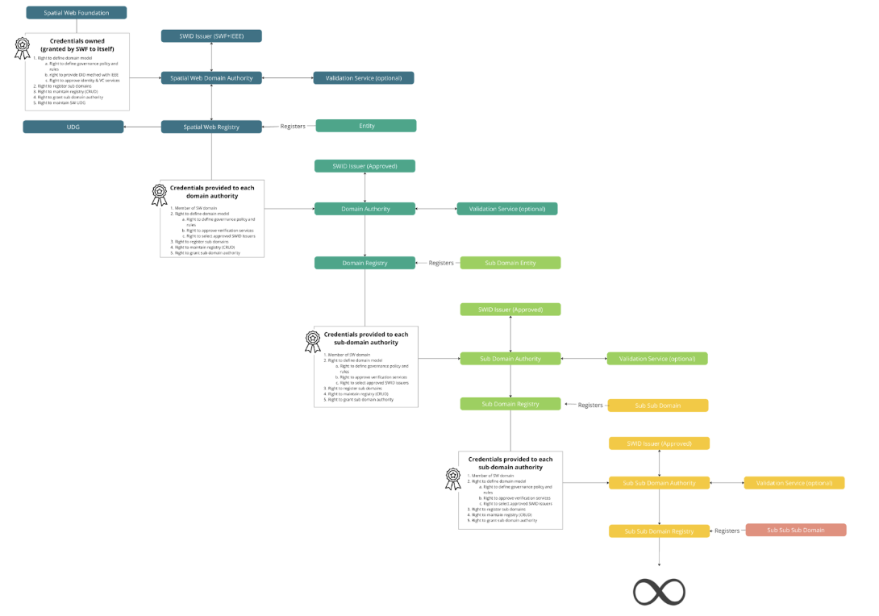
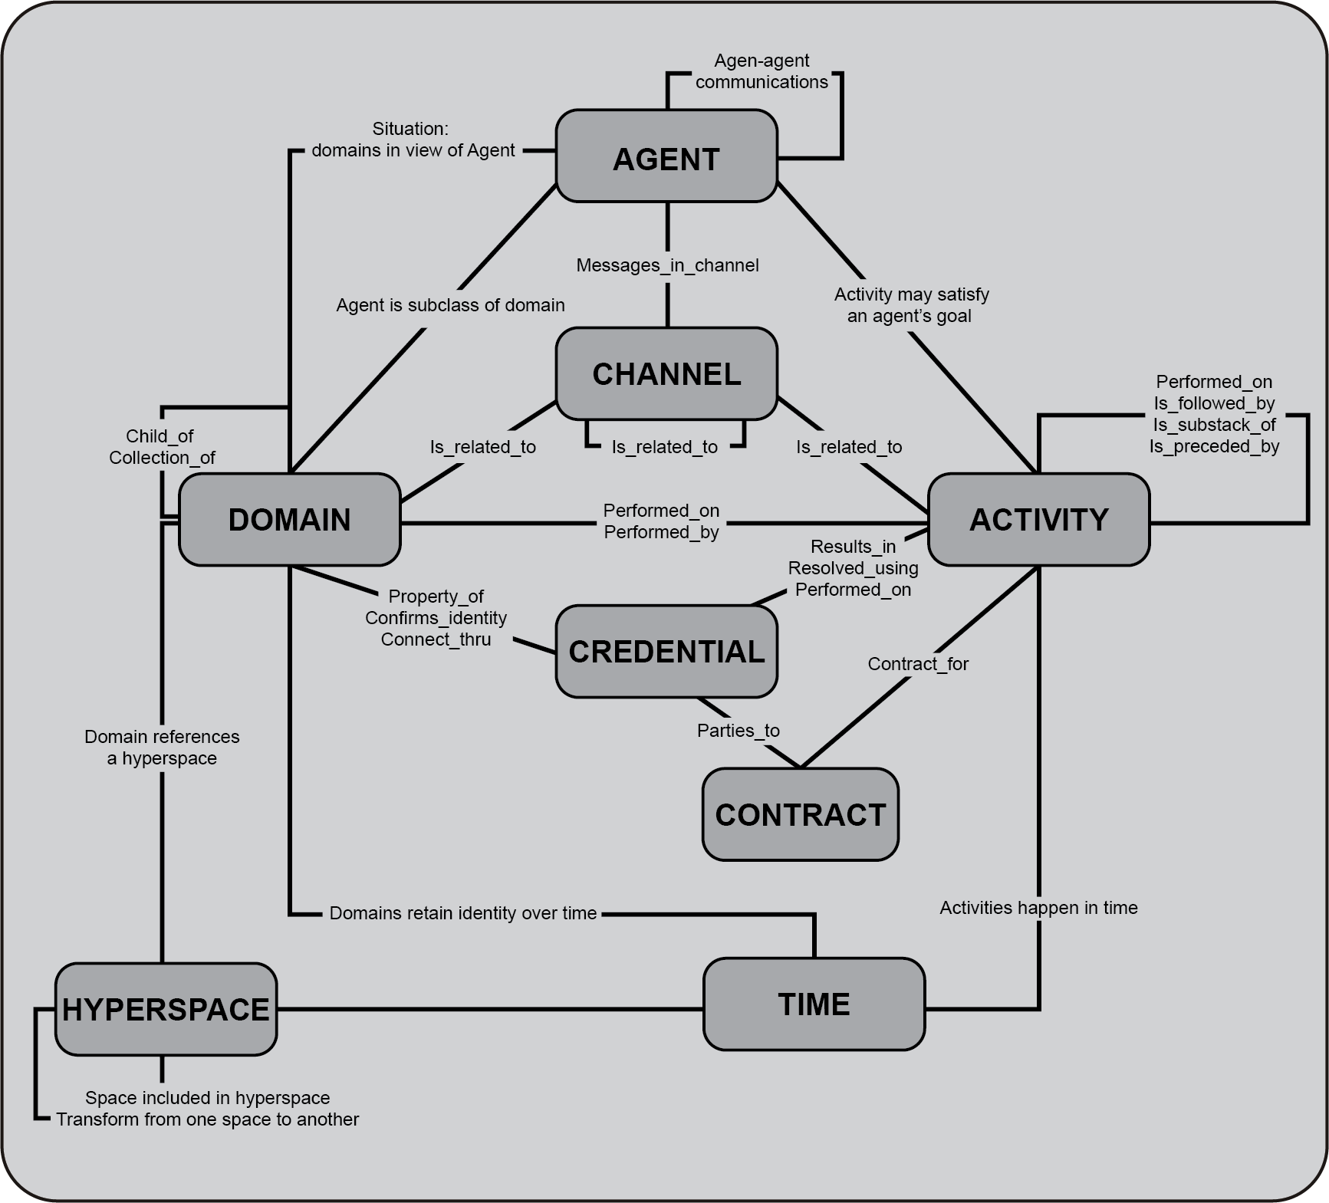
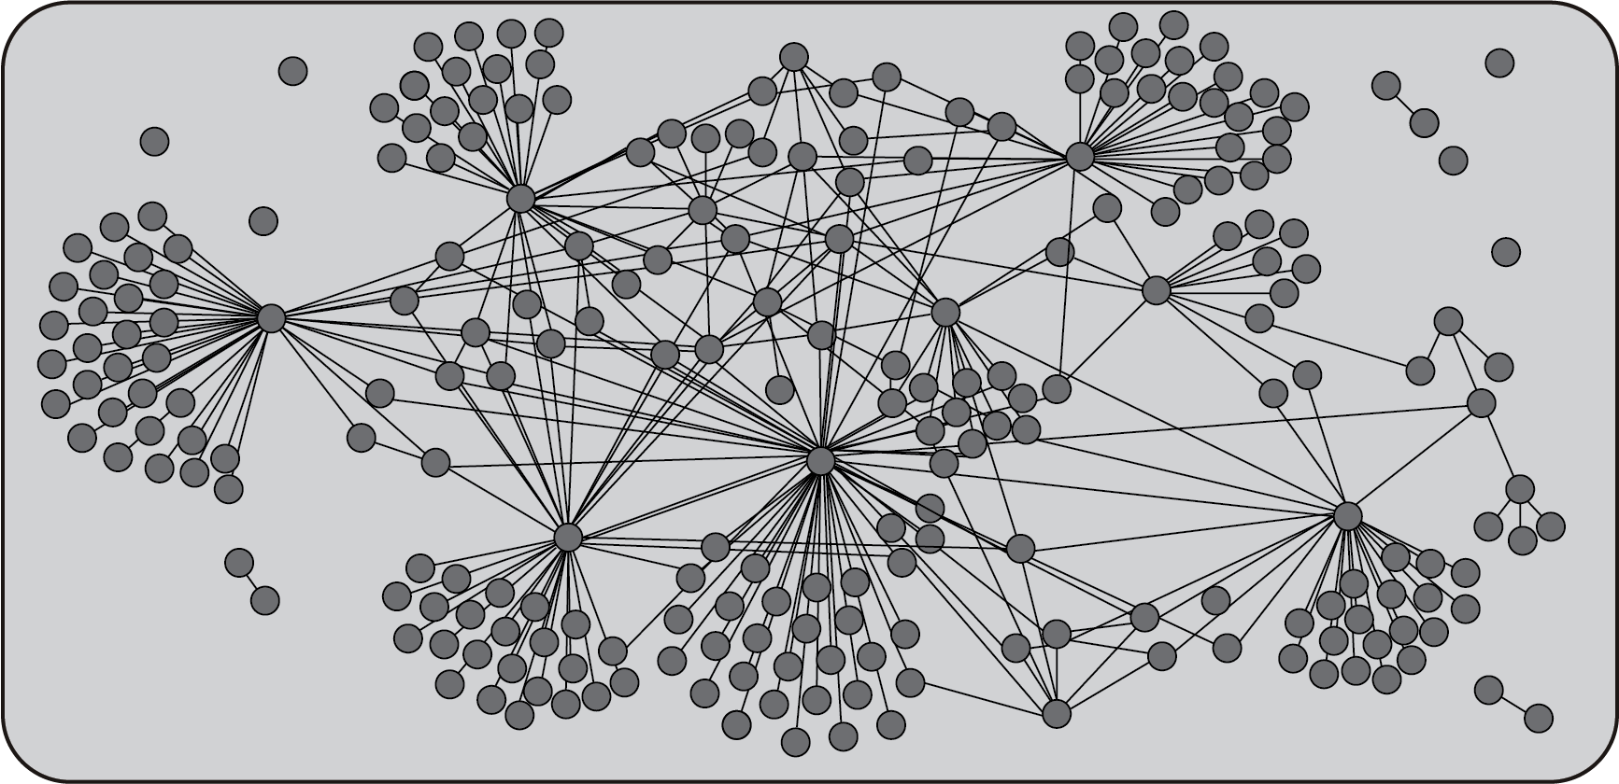
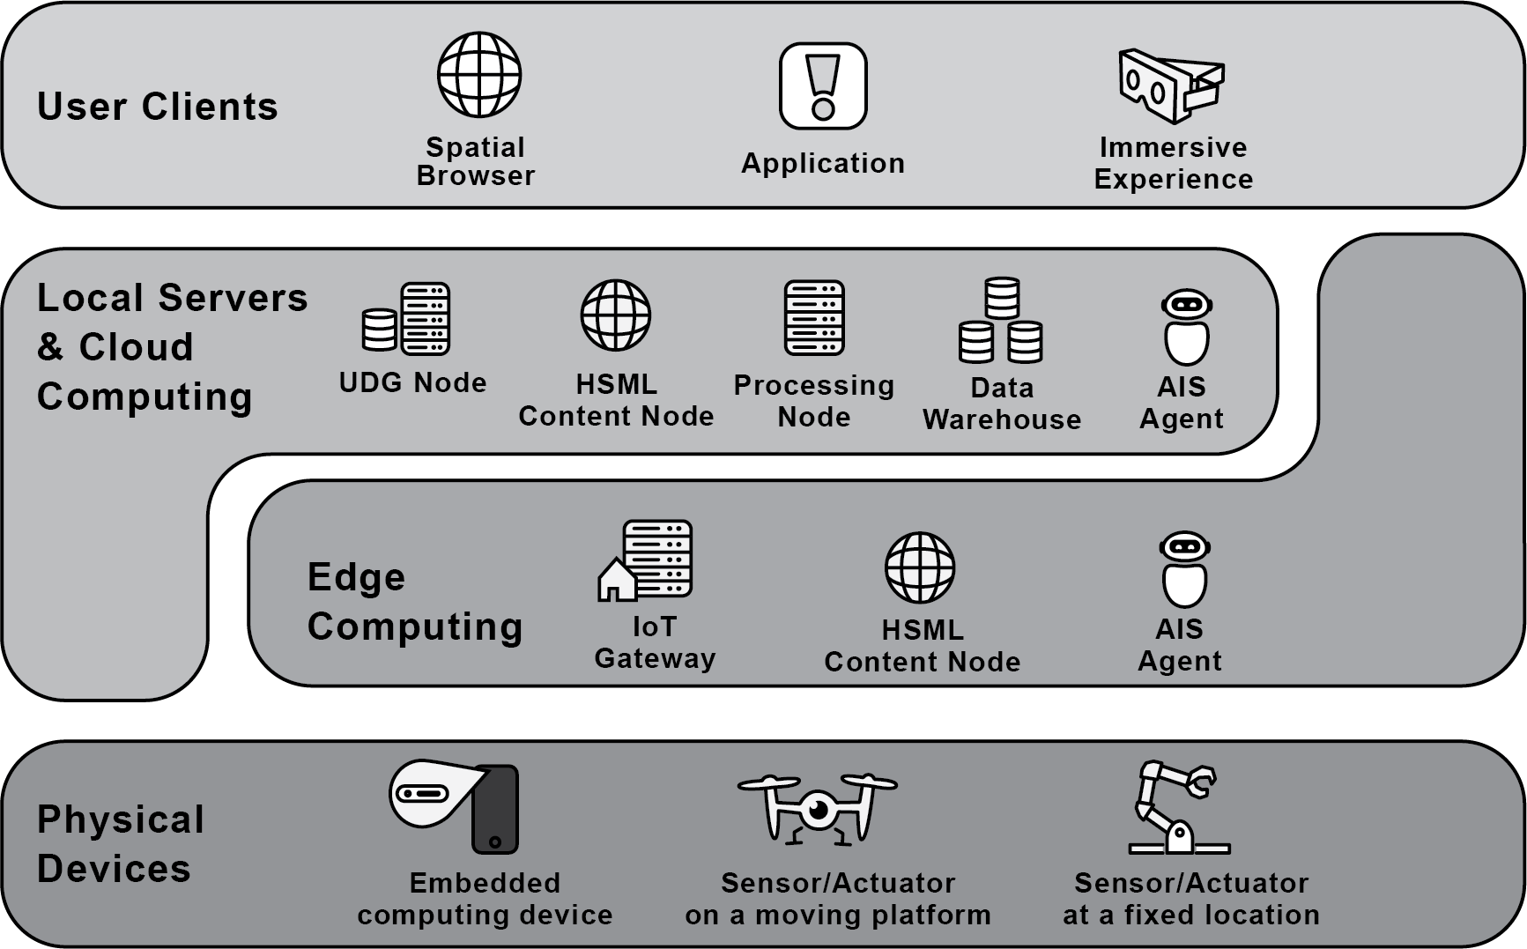
Conceptual views: KG, Social, Registry
Figure 5.1 Enterprise view
Conceptual content hosted on SW nodes
Distrbuted Computing View: SW nodes, HSTP

Slide 2
Figure 6.1 Spatial Web Ontology
ALREADY EXISTS no need to remake
UDG Graph of sw entities

Slide 3
7.1 UDG network of registries
Orginally developed by Capm
Needs
to look like other SWF diagrams
To be simplified
Registries in the UDG

Slide 4
UDG social network
Already exists.
No need to remake

Slide 5
Deployment
Already exists.
No need to remake

